Slide 1


“Pipelines and People – A Workable Solution”
James A. Kent
President, JKA Group
Denver, Colorado
Kevin Preister
Center for Social Ecology & Public Policy
Ashland, Oregon
IRWA Educational Conference
Hartford, Connecticut
June 21-26, 2014
www.jkagroup.com

Slide 2

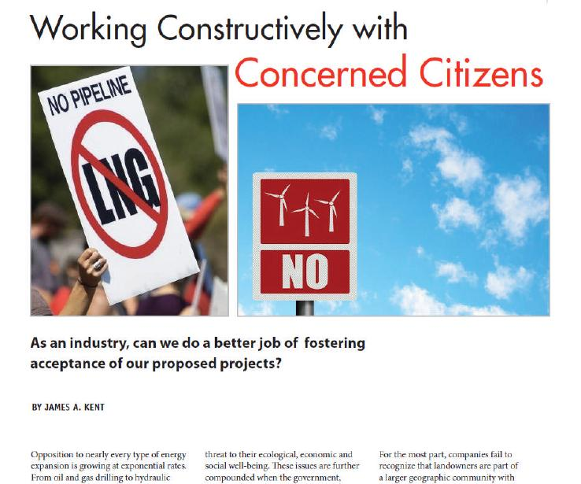
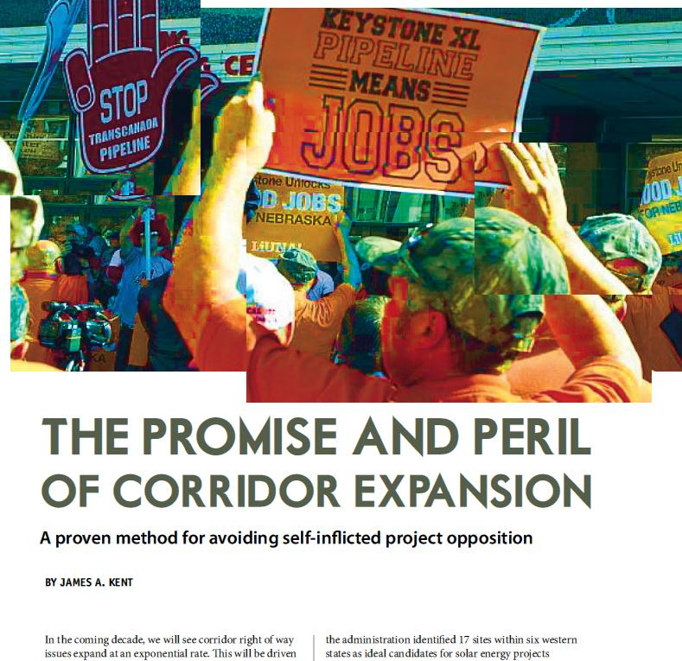
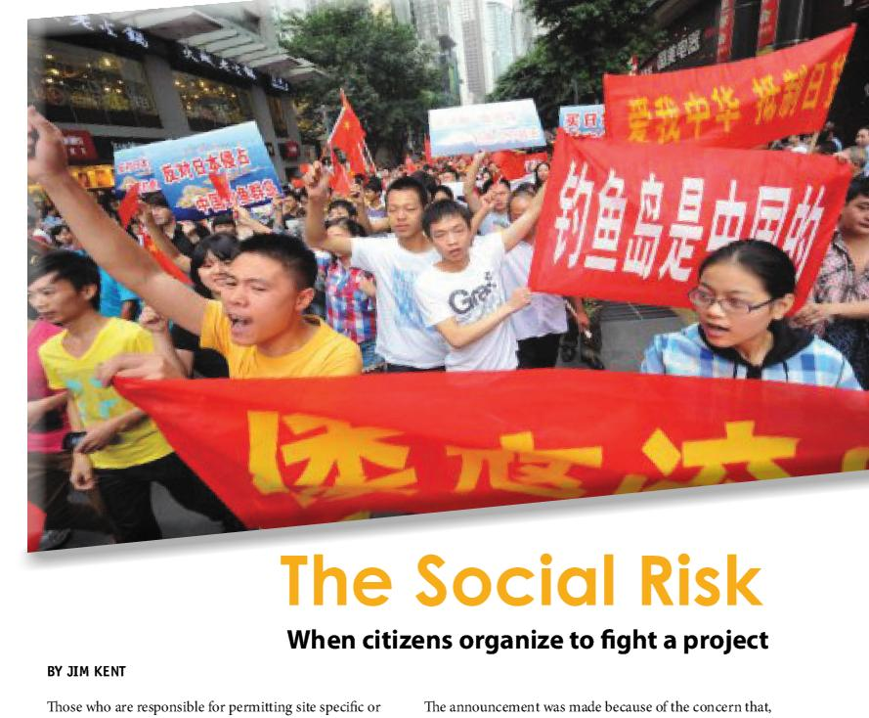

IRWA Articles on: “Social Ecology—the Science of Community”

Slide 3

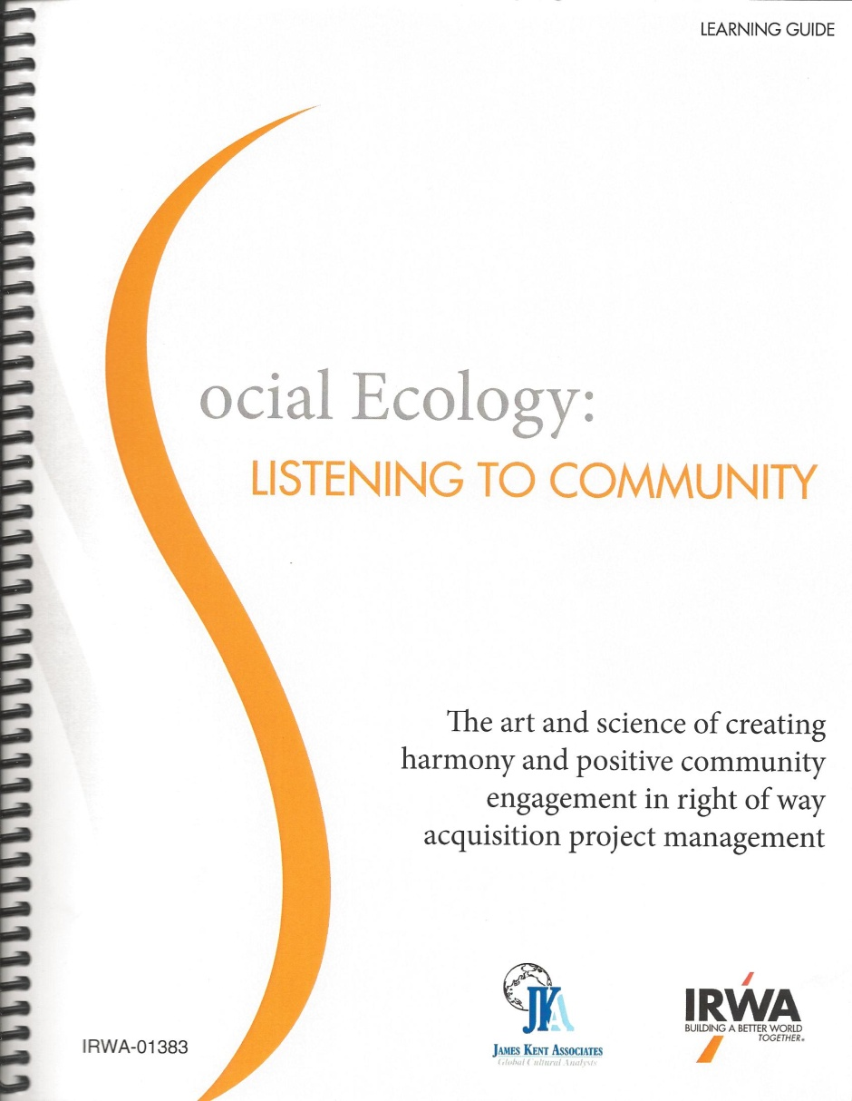

Slide 4
OVERVIEW
"In this and like communities, public sentiment is everything. With public sentiment, nothing can fail; without it nothing can succeed. Consequently he who moulds public sentiment, goes deeper than he who enacts statutes or pronounces decisions. He (the citizen) makes statutes and decisions possible or impossible to be executed."
Abraham Lincoln, from a debate with Stephen Douglas in 1857.

Slide 5

DEVELOPMENT MODELS
Traditional Approach
Design
Propose
Defend
Social Ecology Approach
Learn
Engage
Benefit
©2014 James Kent Associates

Slide 6
OLD MODEL--Ineffective
Formal Impact Model
Traditional Approach
Design
Propose
Defend
Community boundary
Project Intrusion
Community Culture
©2014 James Kent Associates

Slide 7
Headlines
Romanian Farmers Choose Subsistence Over Shale Gas
SUN Newspapers-UK, October 27, 2013
Gazi Park Protests Spread From Istanbul to Ankara
The Times of India, May 31, 2013
Gazi Park Protesters Form Political Party
PressTV, Istanbul, October 25, 2013
Rise in San Paulo Bus Fares Sparks Mass Protests
The Rio Times, June 18, 2013
Hundreds of Thousands March in Brazil Protests
World News, June 21, 2013
Greek Prime Minister Folds, Will Restart Public Broadcaster
Zero Hedge, June 17, 2013
Chino Hills Residents Win Battle Over Power Poles
Inland Empire News, September 25, 2013

Slide 8
NEW MODEL--Effective
Informal Absorption Model
Social Ecology Approach
Learn
Engage
Benefit
Community boundary
“Our”
Community Culture
“Our Project”
©2014 James Kent Associates

Slide 9
Describing Community
“The process is this--one puts down endless observations, questions and remarks. The number grows and grows. Eventually they all seem headed in one direction and then they whirl like sparks out of a bonfire. And then one day they seem to mean something.”
John Steinbeck

Slide 10
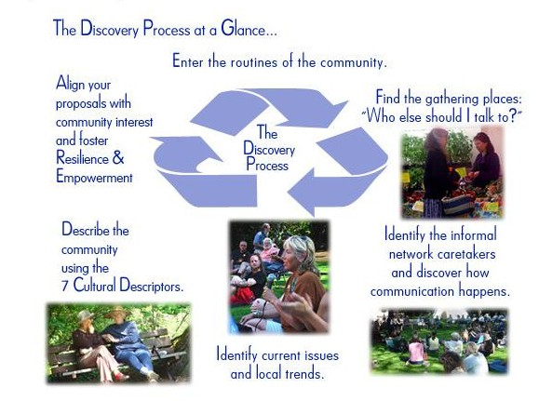
©2014 James Kent Associates

Slide 11
Three Concepts That Position a Company for Citizen-Oriented Management and Policy
Informal Networks and Local Routines
Human Geography
Citizen Issues—Emerging, Existing and Disruptive
©2014 James Kent Associates

Slide 12
TWO FORMS OF CITIZEN ORGANIZATION
HORIZONTAL / INFORMAL
VERTICAL / FORMAL
STRUCTURE
FUNCTION
Caretaking
Survival
Cultural
Political
Economic
Ideological
CHARACTERISTICS
Respected leaders
Flexible goals
Internal recognition of members
Informal communication
Gathering places and natural routines
Elected/appointed leaders
Organizational goals
Membership list
Formal communication
Meeting locations and scheduled times
©2014 James Kent Associates

Slide 13
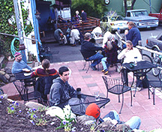
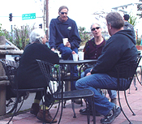
GATHERING PLACES
At the heart of every community are gathering places where people naturally congregate to talk about current events. These places provide a structure for local network systems to thrive.
©2014 James Kent Associates

Slide 14
Three Questions for Use in the Discovery Process™
Why do you live here?
This gives us past culture based on traditions, beliefs, and stories of place. Important for indexing your current activity.
Why do you stay?
This lets us understand present methods of survival, management of their environment and predictive skills as well as cultural maintenance and caretaking activities.
What would you change to make staying better for you?
This gives us the future action needed for a fuller life by assisting with the resolution of emerging, existing and disruptive issues. This keeps you at the interest (emerging and existing issue resolution) rather than at the positional level (disruptive issue conflict)
James Kent Associates

Slide 15
Eight Informal Network Archetypes
Caretaker
Trusted by others
Utilized in time of stress
“Let us talk over the idea.”
Communicator
“Did you know...?”
“I heard that...”
Gatekeeper
Narrows entry
“I can hook you up.”
Bridger
Two cultures
Two languages
“I know somebody from...”
“This is what they’re saying...”
Authenticator
Knowledge and wisdom from the culture Provides cultural interpretations to technical data and information
“This is how we do it here.”
Storyteller
“In the past...”
“We used to do it this way...”
Opportunist
Use of public setting for personal gain
“We in the community...”
“My people....”
Historian
History of their geographic place, carriers of the events that have happened over the lifetime of the community. They know critical information.
©2014 James Kent Associates

Slide 16
Accessing
Networks
Appreciate and get to know historians and storytellers in community.
Identify gathering places and activities where people participate in informal networks. Become individually known in these places.
“Do you know _____?”
“Who else should I talk to about this?”
“People hate to be interviewed but love to talk.”
Do not agree or disagree when someone makes a statement about a “personality.”

Slide 17
Concept Two: Human Geography

Slide 18
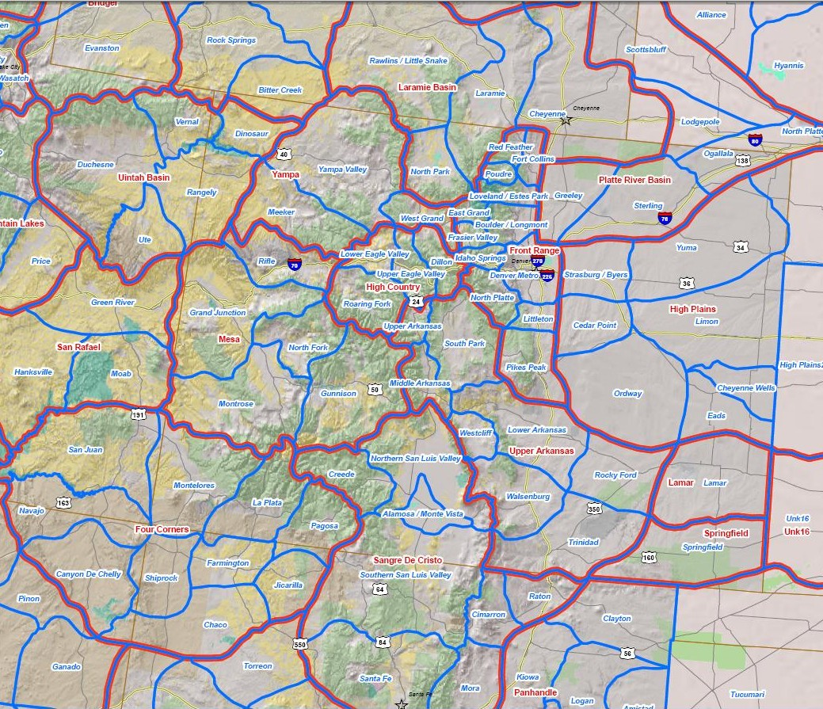
Human Geographic Units of Colorado
©2014 James Kent Associates

Slide 19
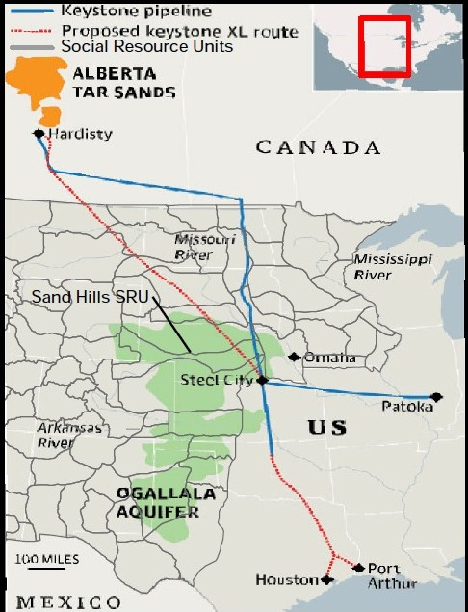
From Right of Way Magazine, IRWA: ”The Promise and Peril of Corridor Expansion” By James A.
Kent, Social Ecology Columnist, Jan/Feb 2012, pages 26 to 29

Slide 20
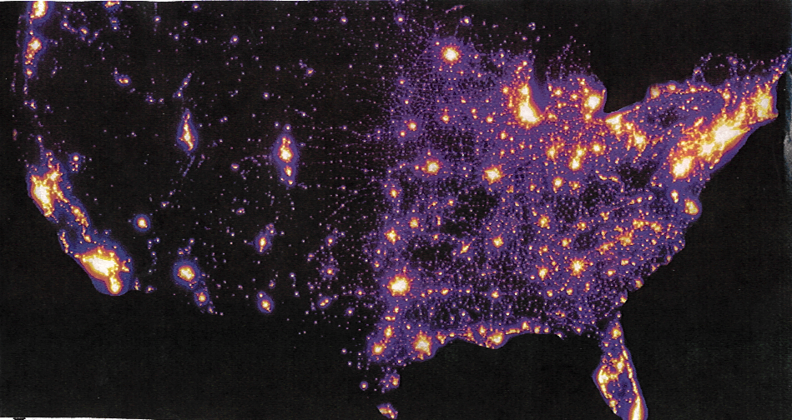

Slide 21
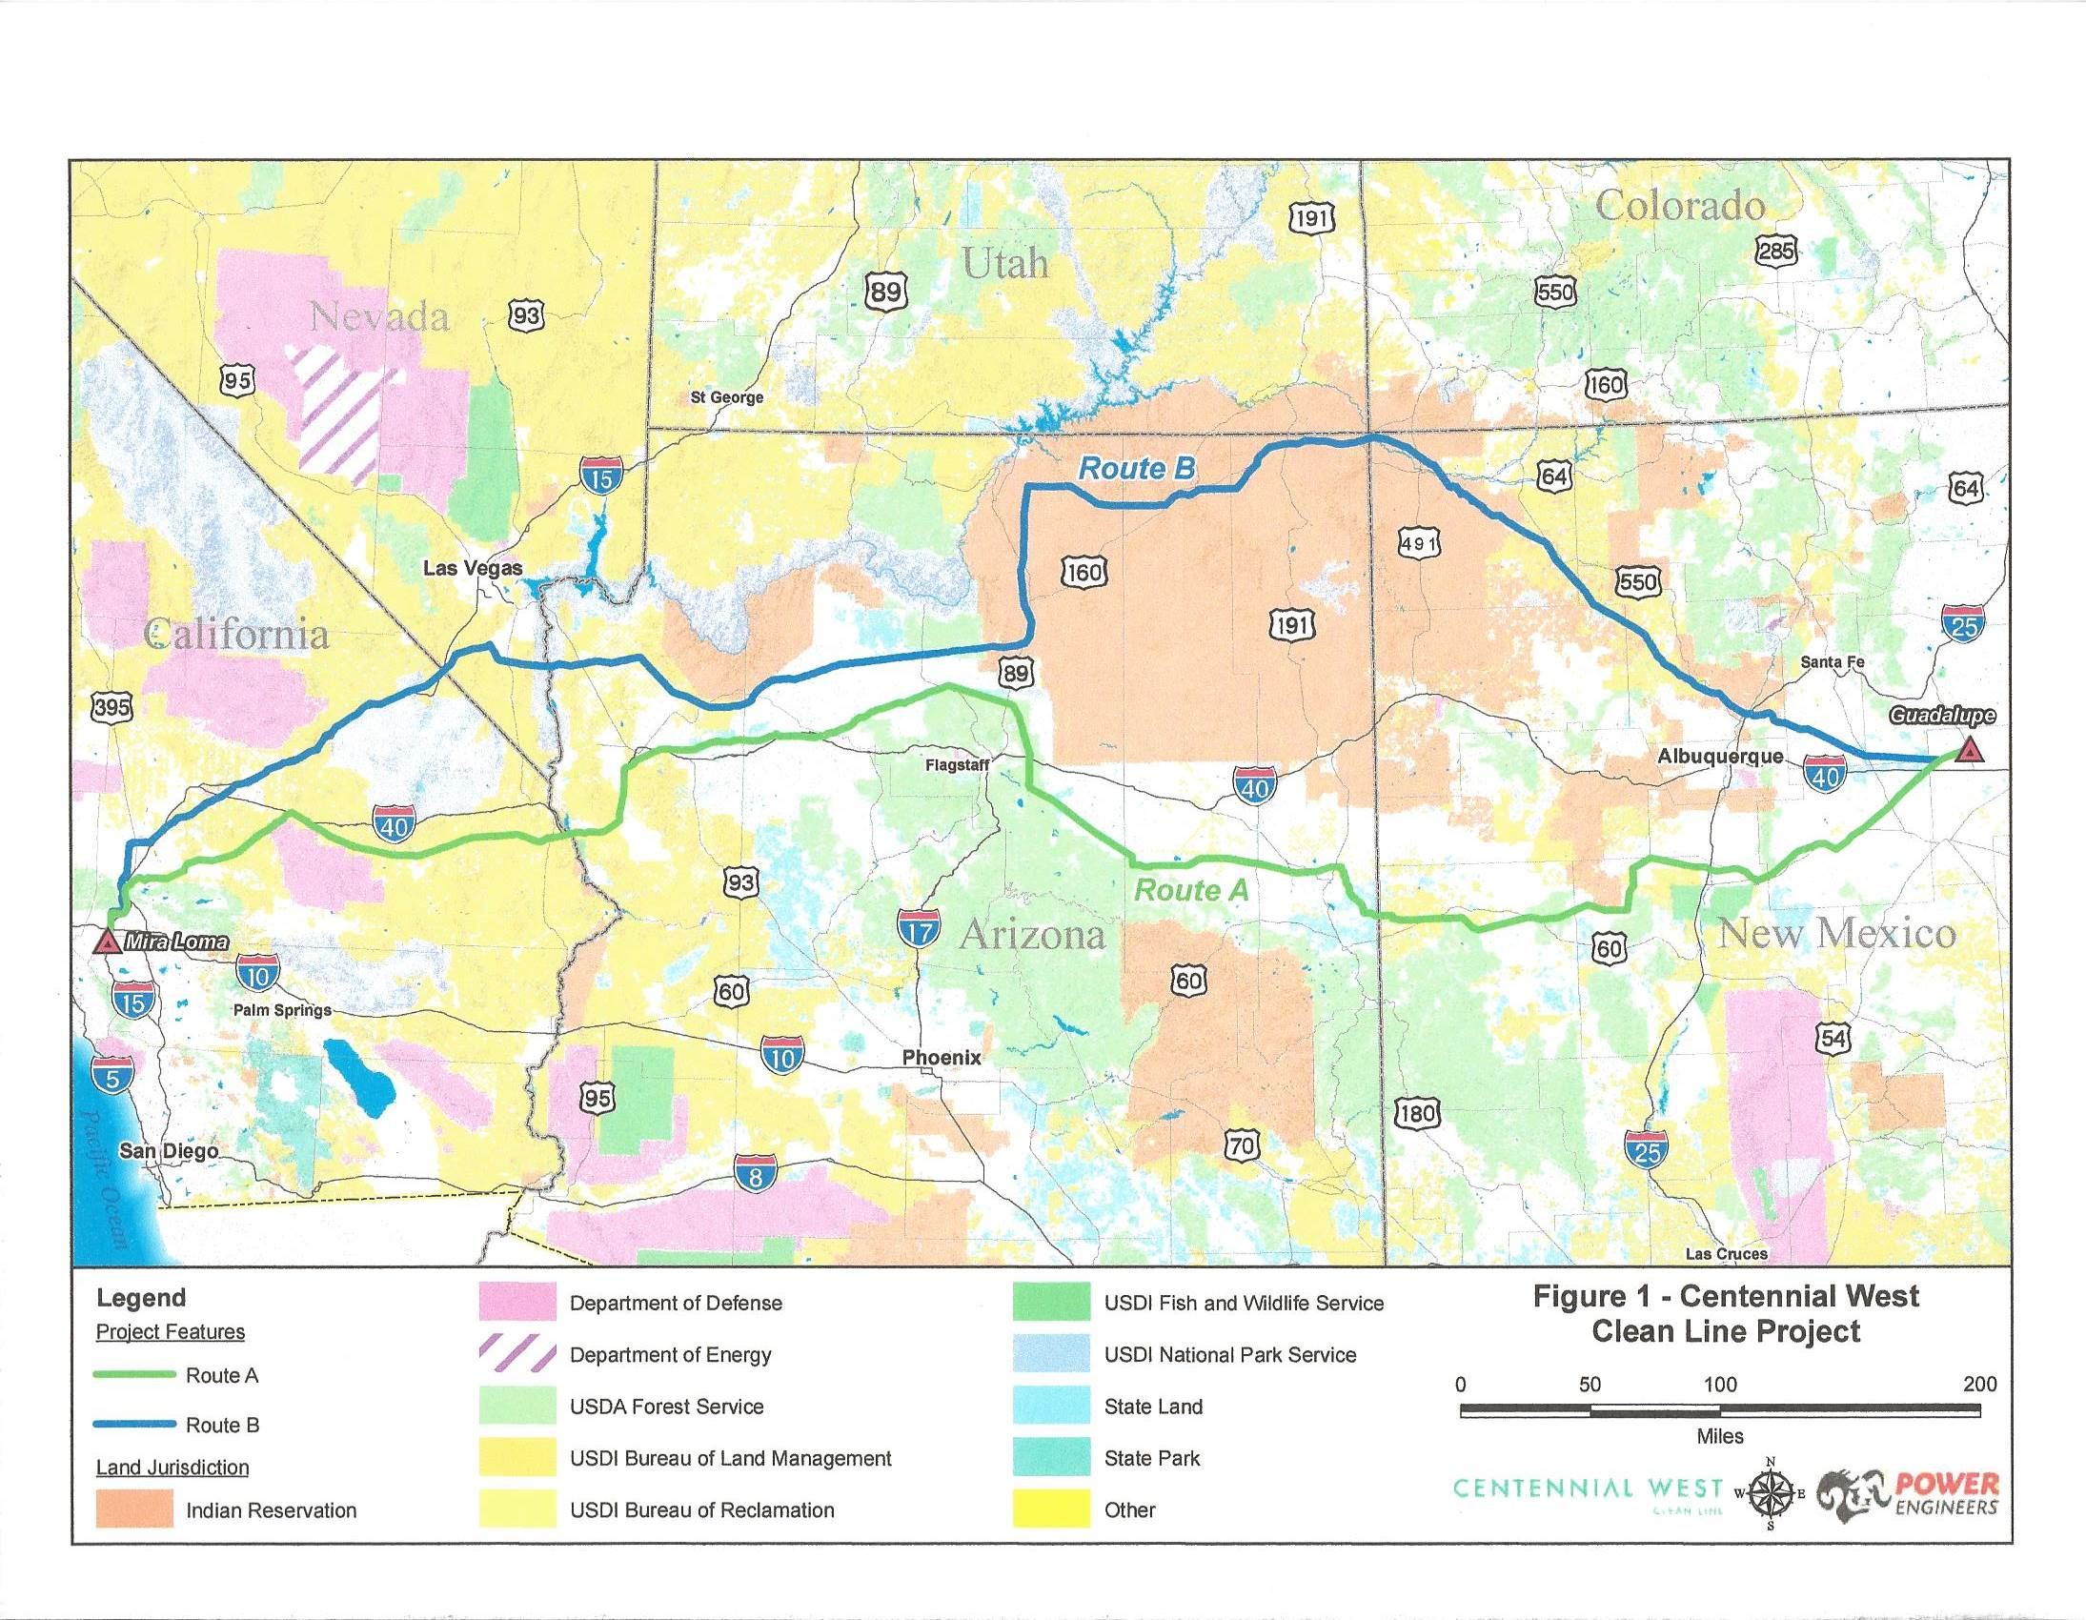
Southwest Transmission Corridor Alignments

Slide 22
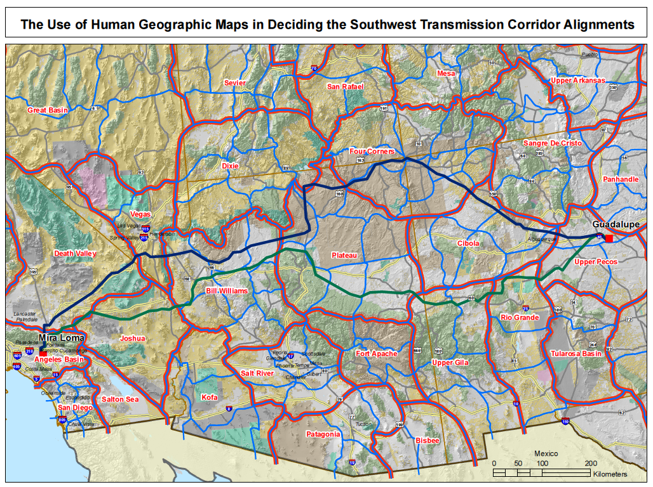

Slide 23
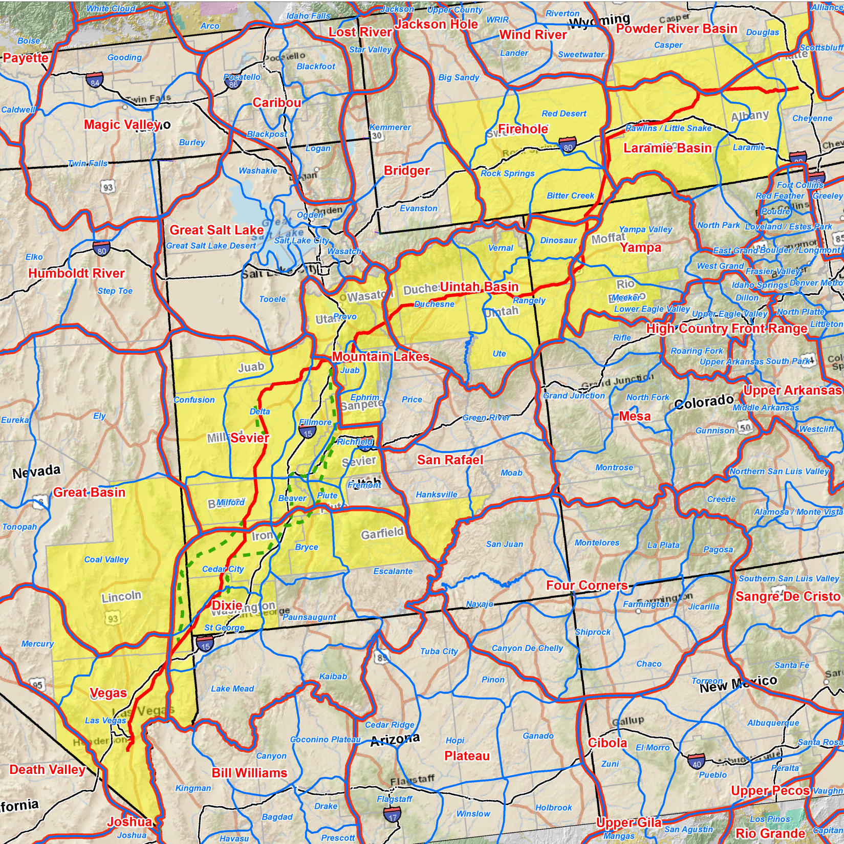
The Zephyr Project Proposed Route with Human Geographic Units Shown

Slide 24
Concept Three: Citizen Issues—Emerging, Existing and Disruptive

Slide 25
The Process of Issue Management
B.
Identify
Management
Opportunities
A.
Identify
Management
Concerns
C.
Implement,
Practice and
Evaluate
TYPICAL PLANNING PROCESS OF COMPANY
Courts
or
Legislature
IMPACT
Company
Public
Interests
STAGE 3
Disruptive
Issue
BYPASSES PLANNING CIRCLE AND GOES TO COURTS OR LEGISLATURE
INCORPORATED INTO ORGANIZATIONAL ACTION
STAGE 1
Emerging
Issue
STAGE 2
Existing
Issue
Derived from “Social Ecology: A New Pathway to Watershed Restoration,” by Kevin Preister and James A. Kent, In Watershed Restoration: Principles and Practices, by Jack E. Williams, Christopher A. Wood and Michael P. Dombeck (eds.), Bethesda, MD.: American Fisheries Society, 1997.
©2014 James Kent Associates

Slide 26
Themes versus Issues
"I am against growth."
"There are sacred spots around here that must be treated with respect."
"I am against growth because the parks are overcrowded and my kids have no place to play."
"The beach is sacred to our people."
"You can't trust government."
"We are ranching country. We take care of our own around here."
"They never sent us the results of the soil testing on our property."
"There is a peregrine falcon pair that nests nearby."
"The agency inflated the board footage it reported in its timber sale from its earlier press release."
"The County is trying to upgrade this road into a freeway."
©2014 James Kent Associates

Slide 27
An Issue Management Program
Action Question:
How can we _______ in ____ (a geographic location) so that we can also______ ________________________?
Citizen Issues
Management Concerns
Communication & Action Opportunities
©2014 James Kent Associates

Slide 28
A Graduated Approach to Citizen Engagement
Discovery Process: One-on-one contact
Chat Sessions
Neighborhood Gatherings
Public Meetings
Time
Inclusiveness
©2014 James Kent Associates

Slide 29
Informal/Formal Systems of Organizations--The Function of the Right-of-Way Professional
Systems Integration and Issue Resolution
Informal
Systems
Formal
Systems
Citizen-centered
Cultural
Communities of Place
Organization-centered
Technical
Publics of Interest
Function
Function
Caretaking
Survival
Cultural Maintenance
Political
Economic
Ideological
Interest Based
Position Based
Gathering Places Networks Word-of-mouth Cultural language Community time
Meetings Focus Groups Technical language Newsletters Institutional time
System Resilience
--Citizen Ownership
System Resilience
--Cultural Alignment
Collaborative
Stewardship
© 2014 James Kent Associates

Slide 31
Power Model
Outside force
pressure
Company
Community-based Model
Impact
Effect: Polarization & Loss of Social Capital
Community
Outside
force
Effect: Community is buffer against outside force—”Our project”
Community
Company
©2014 James Kent Associates

